Slide 1
beHappy
AI4Youth
Authors:
Jakub Stanula-Kaczka
Wiktor Koźlik
Piotr Chajec
Project supervisor:
Marek Braun
Zespół szkół nr 2 im. Eugeniusza Kwiatkowskiego w Dębicy

Slide 2

Information about beHappy
Our Project aims at detecting hate speech and offensive language on social networks in order to protect its Users.
source: https://mycompanypolska.pl/

Slide 3

Why this subject?
Online hate speech is a very common probem on popular social websites used by many Internet users.
Negative emotions strongly affect the psyche of sensitive people, which can have a negative impact on their emotions later on.
source : https://www.casfera.pl/

Slide 4

Goal of the Project
Our Project detects hate speech and warns User agains it.
Protecting the User on social media is extremly important, as toxic online behaviour reflects on all of Us
source : https://pixabay.com/

Slide 5



Scope of the Project
beHappy is currently running on the social networking site Reddit.
The project is divided into 2 modules:
web browser extension (Google Chrome),
artificial intelligence that analyses textual data provided by the extension.
Our Project implements the Sustinable Development Goals:
3 – good health and well-being - Reducing negative emotions reduces the risk of experiencing psychological problems and complexes caused by online toxicity
16 –peace, justice and strong institutions - Our Project reduces virtual violence experienced online
source : https://www.reddit.com/

Slide 6

Expected results
Our Project is designed to:
reduce the level of negative emotions delivered to Internet users,
reduce virtual violence,
increase User comfort while surfing the Internet.
source : https://www.surveyrock.com/

Slide 7
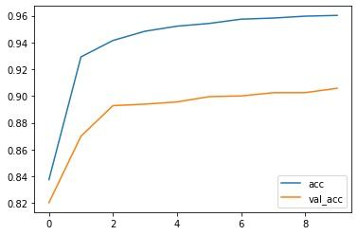
Our Project on charts
Artificial intelligence accuracy

Slide 8

Project development opportunities
The Project will be extended to popular social network sites, e.g. Twitter, in the future.
The aim is to create universal artificial intelligence system that works in multiple languages not just on Reddit.
source: https://blog.masterdataaficionado.com

